Slide 1


FACULTY DEVELOPMENT PROGRAMME on
DATABASE MANAGEMENT SYSTEMS

Slide 2

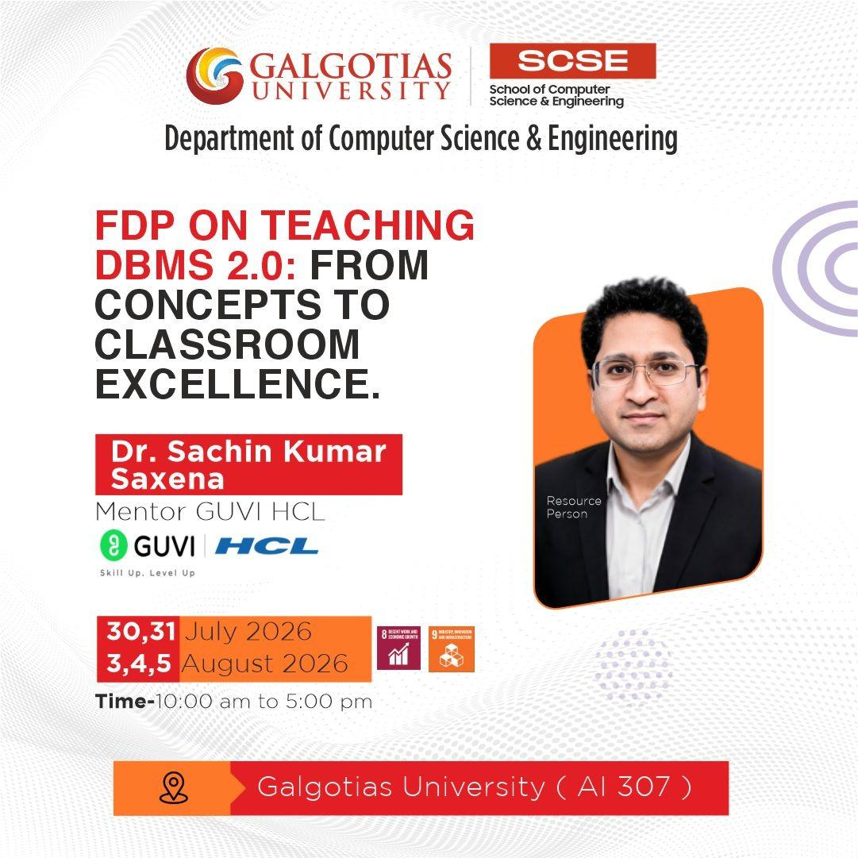

Slide 3
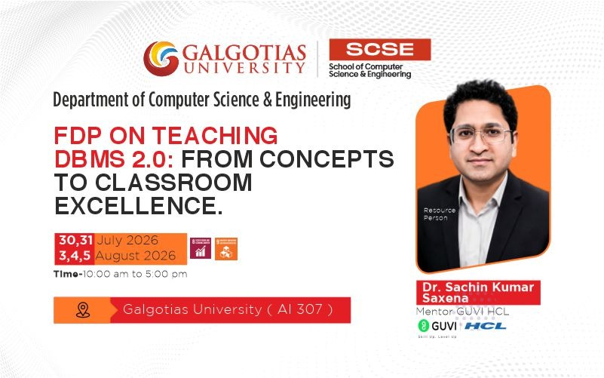

Slide 4
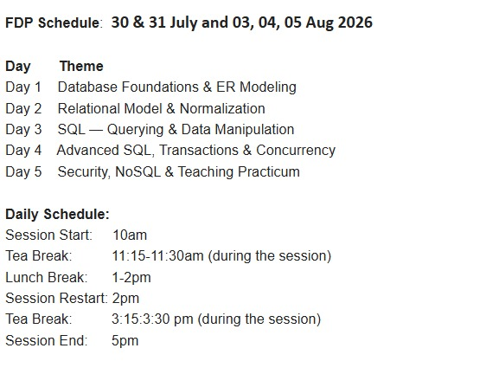
5-Day Hands-on Session

Slide 5
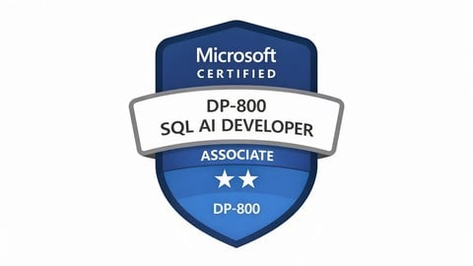

5-Day Hands-on Session will help in other certifications as well

Slide 6

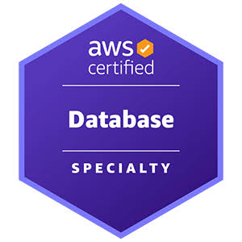
5-Day Hands-on Session will help in other certifications as well

Slide 7

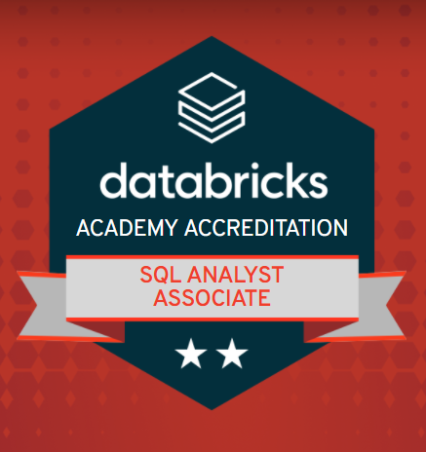
5-Day Hands-on Session will help in other certifications as well

Slide 8
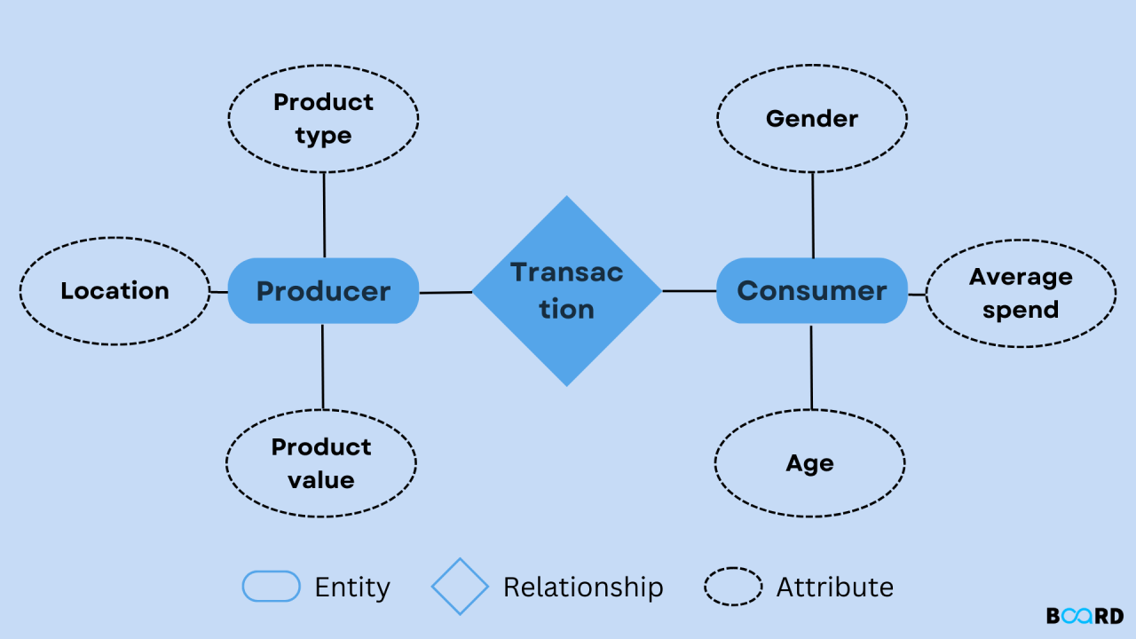

Slide 9
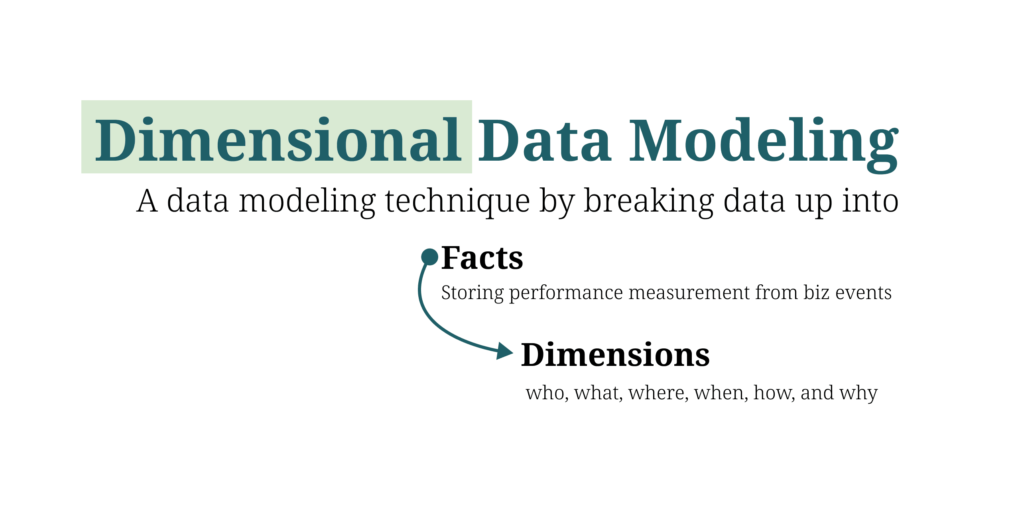

Slide 10
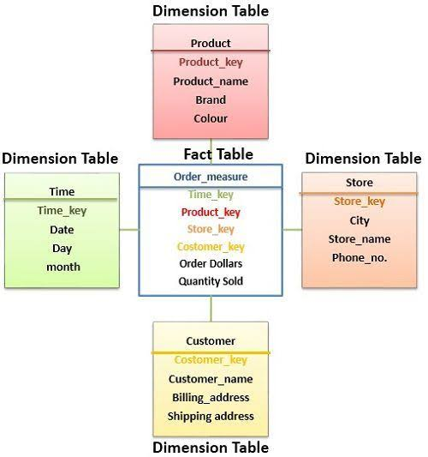

Slide 11
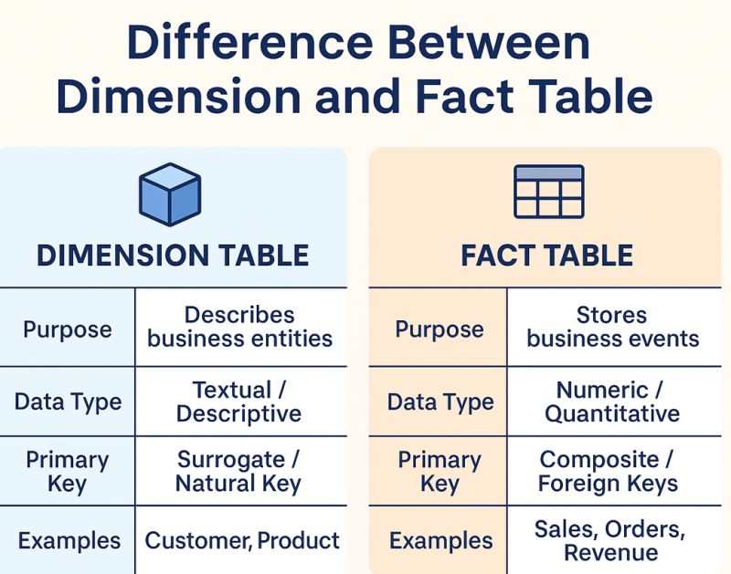

Slide 13
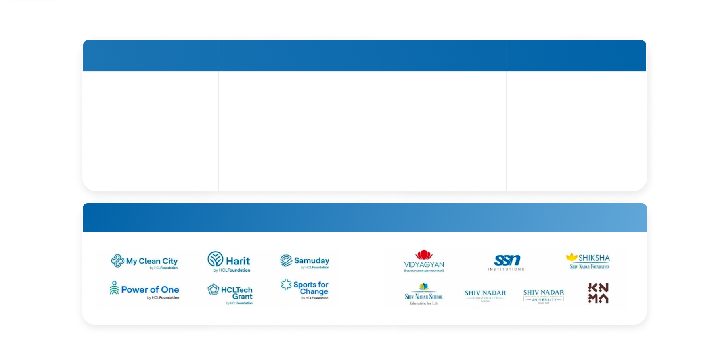
HCL Group Snapshot
HCLTech
HCL Infosystems
HCL Healthcare
GUVI | HCL
A Global Technology
Company Delivering Industry
Leading Capabilities Centered
Around Digital, Engineering,
Cloud, AI And Software,
Powered By A Broad
Portfolio Of Technology
Services And Products.
A System Integration And
Distribution Company. It
Provides Distribution Of
Technology, Mobility And
Consumer Products.
One Of India’S Largest
Corporate Health Solutions
Firms, Providing End-To-End
Healthcare Solutions With A
Vision To Make Corporate
India A Healthier Place.
India’S Leading Vernacular
Skilling Company Dedicated
To Providing Effective And
High-Quality Learning And
Skilling Programs. Trusted By
Over 3 Million Learners And
2000+ Corporate Partners.
HCL Foundation
Shiv Nadar Foundation

Slide 14
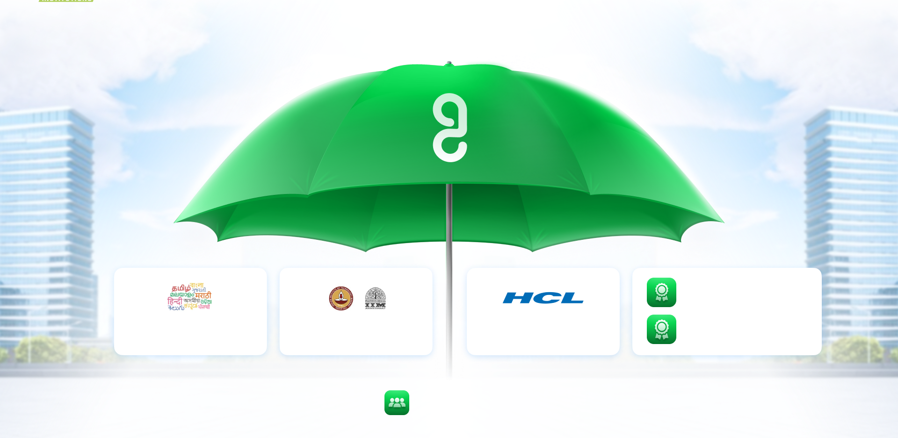
HCL GUVI
A Proven Learning Ecosystem
2024: Guinness World Record for most users to take an AI lesson within 24 hours
Skilling using English &
vernacular languages
Incubated by IIT Madras and IIM Ahmedabad
An HCL Group Company
2021: Guinness World Record for training 1.1 lakhs people on AI within 24 hours
3M+ Learners

